Slide 1
Welcome to Kaiser Permanente
Presenting Medicare 101 and
Kaiser Permanente Senior Advantage (HMO)
Gwinnett County Government
Anni Kuechenmeister
Medicare Account Manager
October 2014

Slide 2
Basics of Medicare

Slide 3
The A, B, C and D’s of Medicare
Medicare

Slide 4
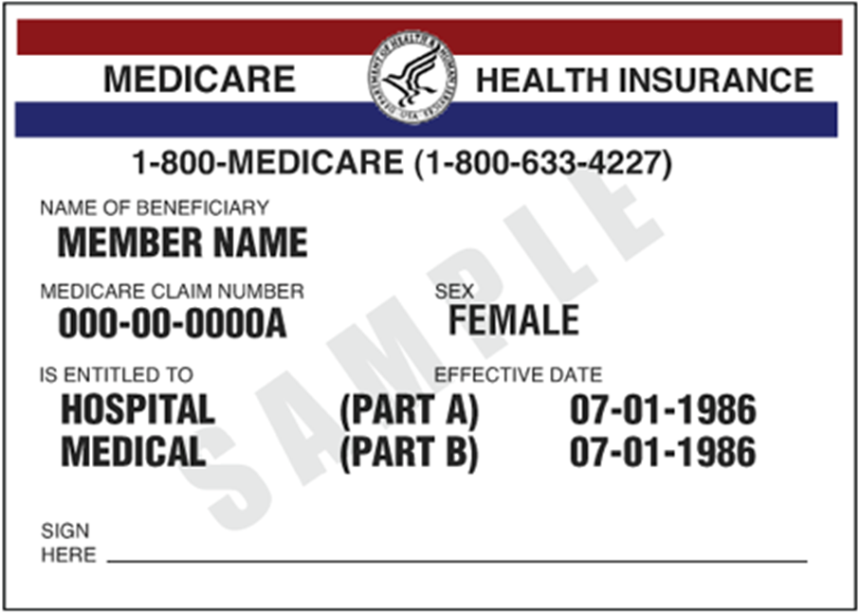
Federally funded health insurance program for eligible beneficiaries.
Established in 1965.
Administered by the Centers for Medicare & Medicaid Services (CMS).
Medicare

Slide 5
Who is eligible?
Medicare beneficiaries include:
Individuals 65 or older if they or their spouses are eligible for
Social Security.
Individuals under 65 who are disabled.
  Must be eligible for Social Security disability
  Requires 2-year waiting period
Individuals of any age with end-stage renal (kidney) disease (ESRD).
  Permanent kidney failure requiring dialysis
  Requiring a kidney transplant
4

Slide 6
Enrollment Periods
  Initial enrollment period: 7 months
    3 months before birthday
    The month of birth
    3 months after the birthday month
  Special Election Period
    Example: After retirement
  During general enrollment period
    January 1st to March 31st
4

Slide 7
Medicare Part D
  Provides outpatient prescription drug coverage.
Enrolling in Part D
  Private insurer plan, such as Kaiser Permanente.
  Prescription Drug Plan (PDP): A plan type that offers prescription drugs only.
Late enrollment penalty (LEP)
  As with Part B, you must obtain Part D or creditable Part D coverage as soon as you are eligible or you will be charged a penalty.
  LEP is 1 percent of that year’s Part D base premium per month that enrollment is deferred.
Note: Unlike Parts A and B, Part D is enrolled directly with the plan.
Part D is not available through Medicare or Social Security.
10

Slide 8
Kaiser Permanente and
The Senior Advantage Plan (HMO)
All of the following information regarding Kaiser Permanente Senior Advantage applies only to Gwinnett County Members who have or are eligible for Medicare.

Slide 9
Gain confidence with
Medicare Star Quality Ratings
See our ratings at kp.org/medicare

Slide 10
Senior Advantage
Senior Advantage provides services covered by Medicare (including Medicare Part D prescription drug coverage).
As a Senior Advantage member, you get your Medicare benefits through Kaiser Permanente.
To enroll:
Must complete Senior Advantage enrollment form
Have Medicare parts A and B
Reside in the Senior Advantage service area
Current members will be notified
Dependents will remain in HMO plan
15

Slide 11
Gwinnett County Government
Senior Advantage Summary of Benefits
(Jan-Dec 2015)
Services | Notes
Annual Out-of-Pocket Maximum | $1,500 per calendar year $3,000 per calendar year
Deductible | $300 / $600
Office Visits | $35 per visit
Lab/X-rays | No charge
Outpatient Surgery | $0 per procedure after deductible
Hospitalization Services | $0 per stay after deductible
Emergency Services | $50 per visit
Ambulance Services | $100 per trip
Prescription Drugs Generic and Brand | $10 /$30 for up to a 30-day supply $20/$60 Mail order – 90 day supply
Hearing Aid | $1000 every 36 months/aid
Eyewear | $100 allowance
SilverSneakers ® | No Charge
This is a benefit summary of Gwinnett County Government’ Kaiser Permanente Senior Advantage group plan. All benefits are subject to the definitions, limitations, and exclusions set forth in the Kaiser Permanente Senior Advantage Evidence of Coverage.
18

Slide 12
Contact Information
If you have questions on the Gwinnett County Senior Advantage Group Plan, contact your HR Benefits Department.
Kaiser Permanente Member Services: 1-800-232-4404 (TTY 711), 8 a.m. to 8 p.m., seven days a week.
Social Security: 1-800-772-1213 (TTY 1-800-325-0778), Monday through Friday, 7 a.m. to 7 p.m.
Medicare: 1-800-MEDICARE (1-800-633-4227) TTY 1-877-486-2048, 24 hours a day, seven days a week.
19

Slide 13
Why Choose Kaiser Permanente?
We can help you make a decision

Slide 14
Who We Are
9 million members
Over 1 million Kaiser Permanente Medicare Health Plan members

Slide 15


Slide 16



Partnership in Wellness
Managing Illness
Preventing Illness
A Healthier You

Slide 17


Slide 18

Quality of Doctors

Slide 19

Choice of Doctor

Slide 20


Slide 21




Convenient Services

Slide 22
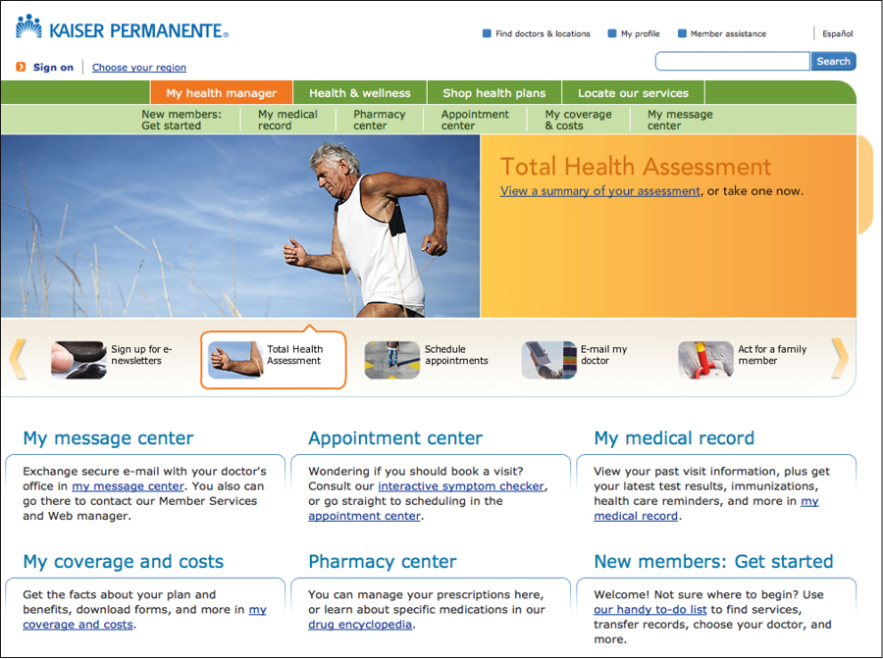
My Health Manager
Manage your health online. Anytime. Anywhere.

Slide 23


My Health Manager
Manage your health online. Anytime. Anywhere.
Make or change appointments
Get routine test results
Email your doctor’s office
Refill prescriptions
Mobile device

Slide 24

Nurse Advice – 24/7

Slide 25


Slide 26




Integrated Care

Slide 27
Electronic Medical Records

Slide 28


Slide 29

Comprehensive Coverage
Doctor Visit
Urgent Care
Emergency Care (Worldwide)
Lab and X-ray
Prescriptions (Part D)

Slide 30

Keeping You Healthy

Slide 31
Thank you from Kaiser Permanente

